Slide 1
CSE 599: Assignment 1 Interactive Nightlight
Created by Emilia Gan
April 18, 2019

Slide 2
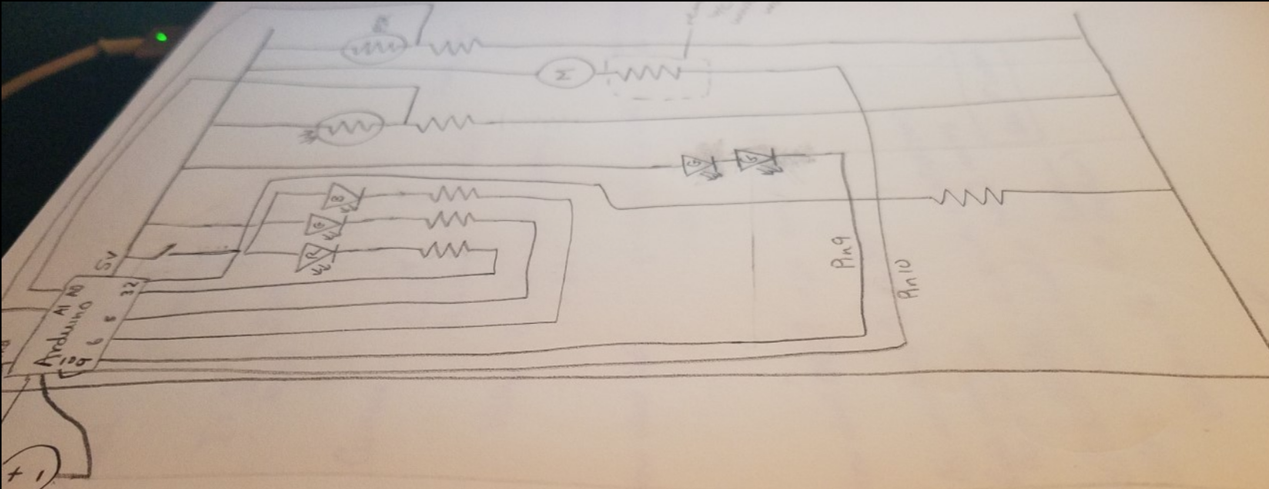
Overview
When I think of nightlights, I think of kids who are afraid of the dark and who need something to calm them.
I wanted the nightlight to be soft, friendly, and huggable.
The teddy bear idea came to me early on, but the precise form took more time to figure out.
The circuitry for the bear was done before any fabrication of the outer form was started, as I wanted to make sure each separate component worked.
When creating the bear, I sketched out the bear and made paper cutouts before cutting and sewing the final form.

Slide 3
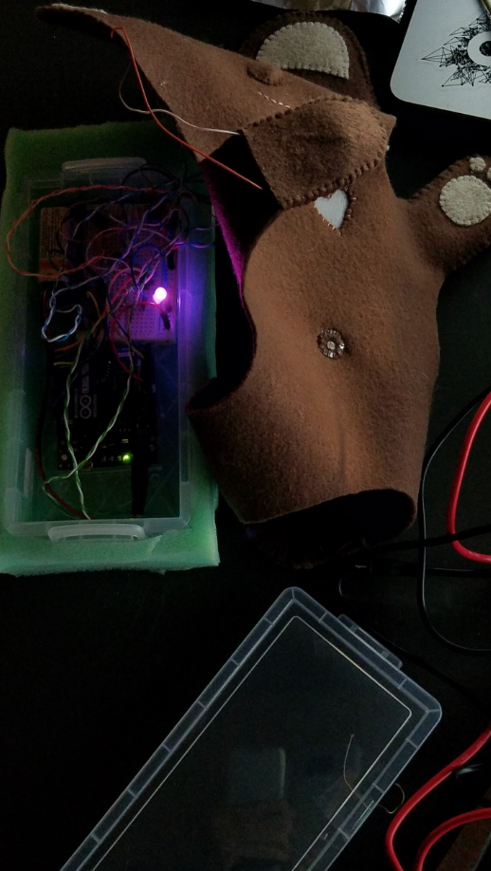
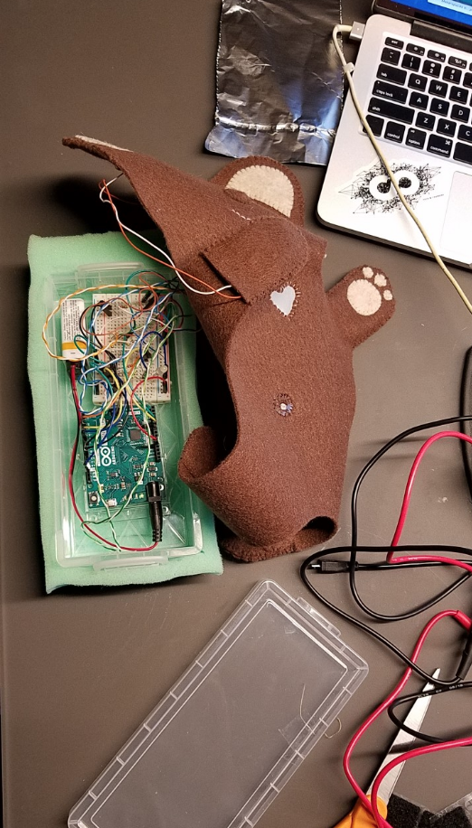
Required Features
The teddy bear’s heart is illuminated with an RGB LED. The light from the RGB LED is diffused using a piece cut out of a plastic bag.
The color of the RGB is adjusted using a homemade low-fi sensor hidden in the bear’s right paw, and brightness varies inversely with the ambient light as measured by a photoresistor in the bear’s belly button.
The bear’s left paw and face contain the elements of the creative feature (described on the next slide).
The bear’s outer form was made of felt, foam, and velcro. Plastic cut from an ID badge holder was used in the heart, eyes, and belly button. The “innards” of the bear (Arduino, breadboard, etc.) are contained in a felt-wrapped box in the bear’s interior.

Slide 4
Creative Feature
The creative component of the project is the bear’s responsive face.
The bear’s left paw contains a hidden off-the-shelf pressure sensor.
The LEDs in the bear’s eyes and the vibrating motor in the bear’s nose are controlled by pressing the bear’s left paw.
The vibrations in the nose can be both felt and heard -- the sound reminds me of the contented purring of a cat.

Slide 5
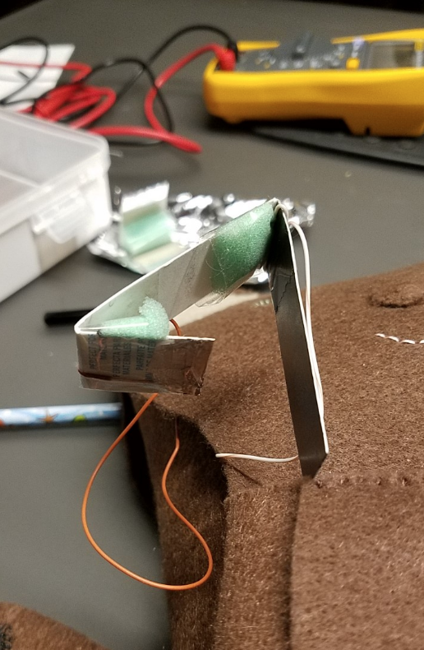
Low-fi Input Sensor
Made from cardboard, tape, foam, tin foil, and pencil
The long end has been coated in pencil lead
The short end has a foil-wrapped tip
When squeezed the short end makes contact with the long end, completing the circuit
As more pressure is applied, the short end makes contact closer to the middle, rather than the tip, of the longer end -- creating a pressure-controlled homemade potentiometer

Slide 6
Struggles & Challenges
The primary source of difficulties in this project was the jury-rigged connections I put together.
Most of these connections were not nearly robust enough.
The interior of the teddy bear is a very confined space, which made assembly difficult.
Adjusting one component often result in disturbing some other component.
Many connections had to be remade more than once.
After all the testing, my battery stopped being able to provide sufficient current ☹

Slide 7
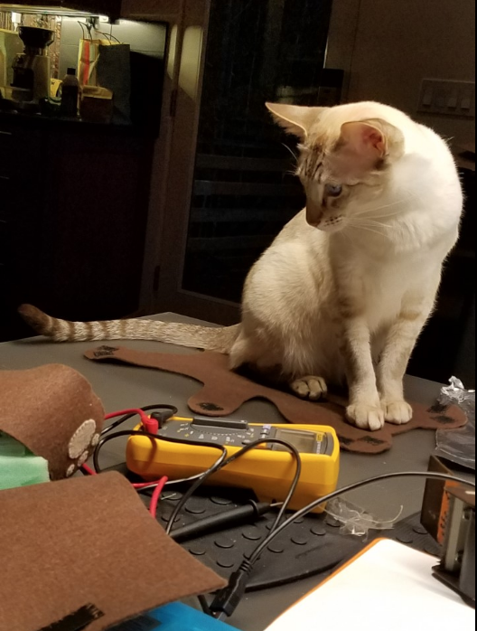
Reflections
Overall, the project was fun. It was satisfying seeing the teddy bear come into existence pretty much as I had envisioned it.
Working with improvised components is frustrating. I really wanted a more stable way to connect parts. On the other hand, more durable connections would have potentially made rearranging/replacing the parts more difficult.
I think my time management and priorities were just about where they needed to be for this project, in terms of getting the circuit down first, then making sure I could assemble the night light. However, I underestimated the amount of time debugging due to parts coming disconnected would take.
I liked making the low-fi input sensor, even though the range of its signal (as measured by the multimeter) was pretty small.
My cats approved of this project.

Slide 8
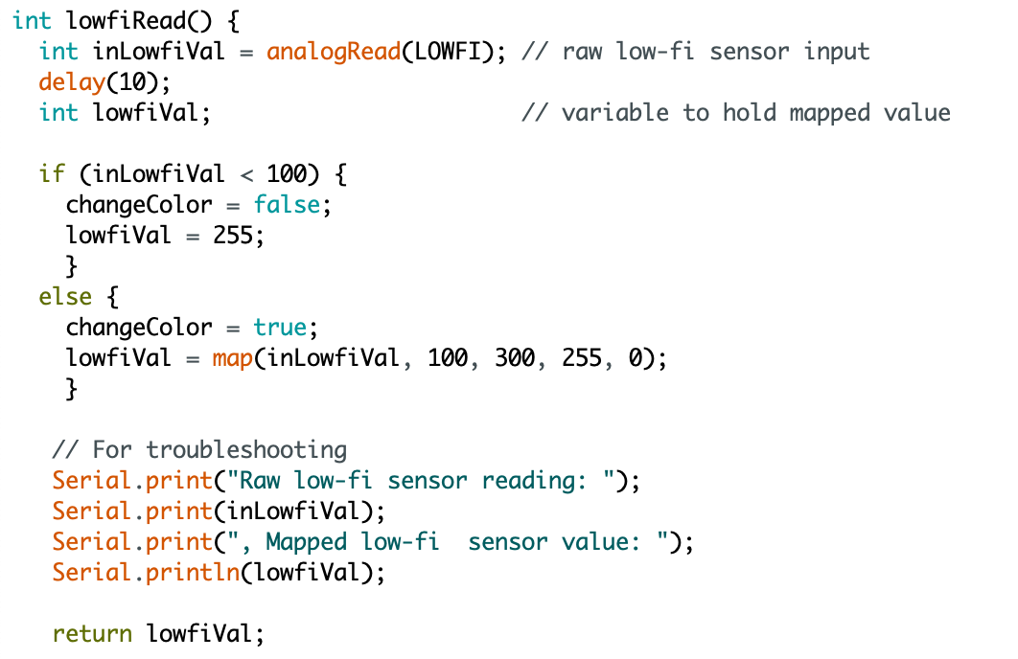
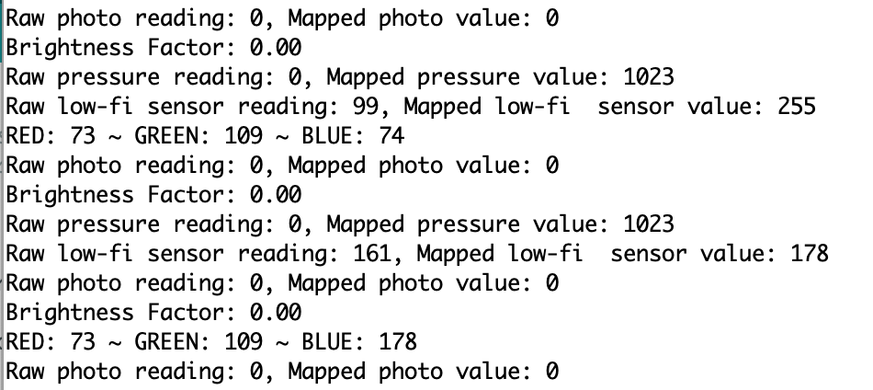
Code & Video Links
Video:
https://www.youtube.com/watch?v=zl_usvlVTuY
Code:
https://github.com/efran/CSE599_Spr19/blob/master/A1_apr15.ino

